Slide 1
Two-way Communication between Deaf(Dumb) and Normal People using Deep Learning

Slide 2
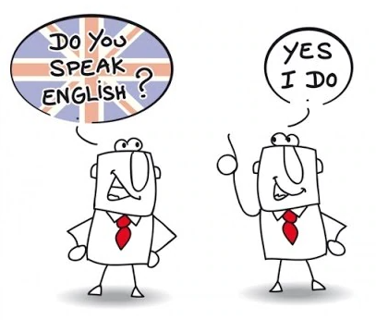
Introduction
Humans need a language to communicate with each other so, what’s the issue here?
Regular(English) vs Sign Language

Slide 3
Regular and Sign Languages are completely different one.
Can we create a bridge between both languages? Yes

Slide 4

Translators are bridges
Human SL Translators
Hand Gloves

Slide 5
Motivation
In order to provide the right to communicate effectively, where a person with hearing impairment can communicate with the one who has no prior knowledge of sign language. This bridge enables normal individuals to understand the sign language and communicates with them.

Slide 6
Two-way Communication

Slide 7
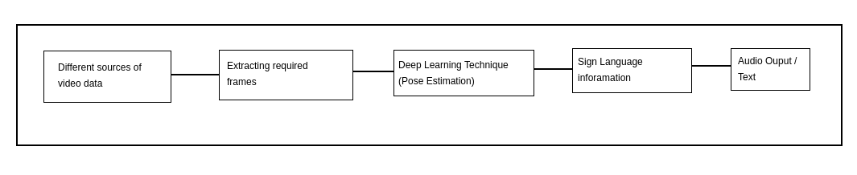
Work Flow
Step 1. When a Deaf-Dumb person(DDP), wants to communicate with the Normal Person (NP), we can capture the hand gestures and facial expressions via a device camera, analyzing them using the deep learning techniques and the appropriate meanings are output as voice/text.

Slide 8
Step-by-step approach
Capturing videos of different sign words based on the ISL
Cleaning the videosets according to individual signs
Extracting the frames out of each videoset
Normalising the images
Estimating the pose and finding the key points the images using Pose Net
Training the neural network, based on the poses
The analysed information, is outputed.

Slide 9
Challenges
Latency : Processing can be slow
Lack of Gesture Language : Different people, different gestures
Robustness: The hand gesture motions can’t be read optimally because different environment conditions
Performance: Gesture recognition require intensive work do be done, it’s difficult to run on resource constrained devices.

Slide 10
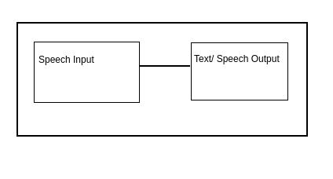
Step 2. In response to it, NP can record the information, which wants to be conveyed, this information is converted using the voice to text API as a text, which can be read by the DDP.

Slide 11
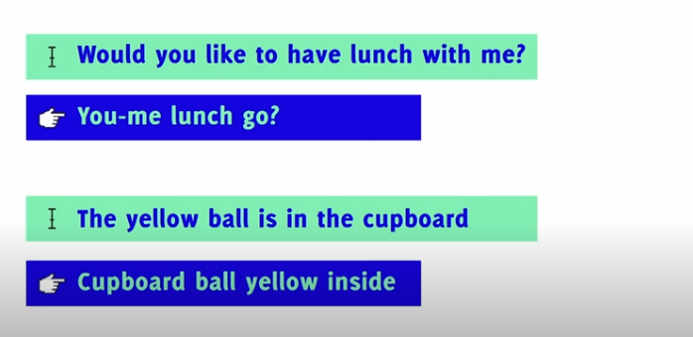
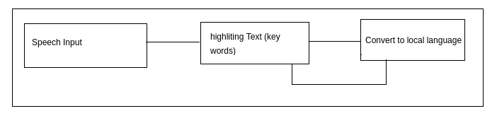

Slide 12
Step-by-step approach
Speech input is recorded using the microphone
Text is generated from the input-ed speech
Keywords of the text is highlighted.
Language translation APIs to translate into desired language.

Slide 13
Conclusion and Future Work
Using Pose Estimation of an individual gather precise information, rather taking time to train to the same pose in different angles(slight deviations)
These two-way approach, provides a chance to increase the communication between two different language community people.
In future, more efficient ways can be developed using 3D avatars for better communications.
Based on similar idea, applications can be developed by integrating the code into devices which enables hassle less mode for two-way communication and better understandings.

